Slide 1


Production of Quality Concrete
Joshua Murphy
Sales Engineer
Master Builders Technologies

Slide 2
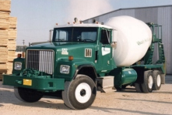

Slide 3

Concrete Mixing Truck

Slide 4

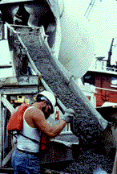
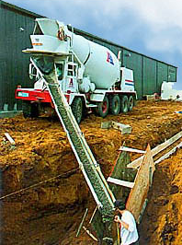
Mixing truck discharge

Slide 5
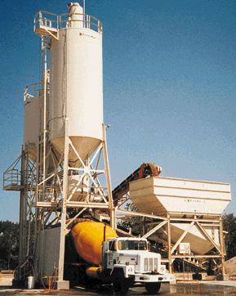
Dry Batch Concrete Plant
Major Components
Bulk Dry Storage Silos
  Cement
  Fly Ash
Aggregate Storage Bins
Aggregate Scale
Cementitious Scale
Charging Belt
Radial Stacker
Water Meter / Scale
Discharge Boot

Slide 6

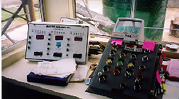
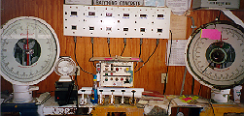

Batch Controls
Manual Batch Panel
Valve Batching System
Batch Computer

Slide 7
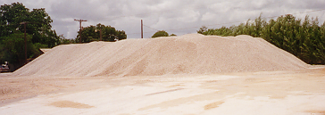
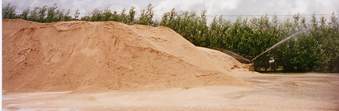
Stockpiles
Limestone Stockpile
Sand Stockpile with Sprinkler

Slide 8

Who has the greatest effect on concrete quality?

Slide 9
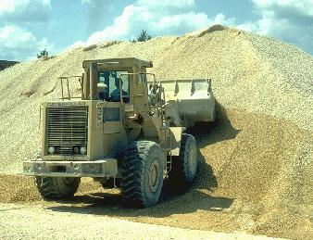

Who has the greatest effect on concrete quality?
The Loader Man

Slide 10
Characteristics of Aggregates
Gradation
Particle Shape and Surface Texture
Unit Weight
Voids
Specific Gravity
Absorption
Surface Moisture

Slide 11
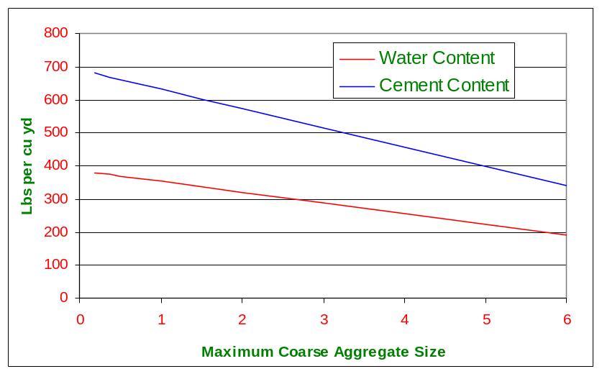
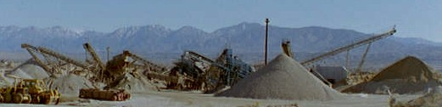
Coarse Aggregate
Gradation
  Water Demand
  Cement Content
  Weight of Sand Needed

Slide 12
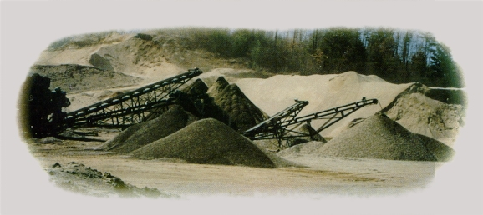
Fine Aggregate
Fineness Modulus
  Between 2.3 and 3.1
  <0.2 variance
Percent Passing #50
  Workability
  Bleeding
  Air Entrainment
Percent Passing #200
  Decrease Strength
  Increase Water Demand
  Increase Bleed Water
Moisture
  Actual batch weights must be adjusted for moisture content

Slide 13
Portland Cement
Type I normal
Type IA normal, air-entraining
Type II moderate sulfate resistance
Type III high early strength
Type IV low heat of hydration
Type V high sulfate resistance

Slide 14

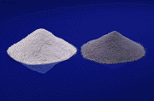
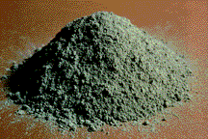
Portland Cement Active Compounds
Tricalcium Silicate = C₃S
Dicalcium Silicate = C₂S
Tricalcium Aluminate = C₃A
Tetracalcium Aluminoferrite = C₄AF

Slide 15
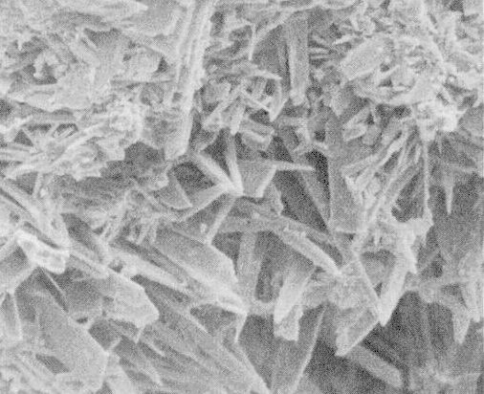

Slide 16
Hydrated Cement
X2000

Slide 17

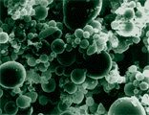
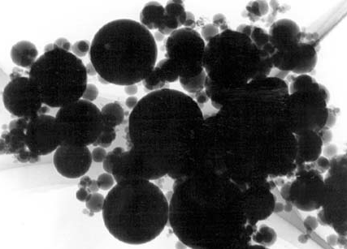
Mineral Admixtures
Cementitious Materials
  Ground Blast-Furnace Slag
  Hydraulic Hydrated Lime
Pozzolanic Materials
  Fly Ash
  Silica Fume
Cementitious and Pozzolanic Materials
Fly Ash 1,000X
Silica-Fume 20,000X

Slide 18
Chemical Reactions
Cement/Water Reaction
C₃S + C₂S + C₃A + C₄AF + H₂O =
Calcium Silicate Hydrate + Ca(OH)₂ + Other Compounds
Fly Ash/Ca(OH)₂ Reaction
Fly Ash + Ca(OH)₂ =
Calcium Silicate Hydrate + Other Compounds

Slide 19
Effects of Fly Ash on Plastic Concrete
Decreased water requirement
Increases quantity of air entrainment admix needed
Increase workability
Decrease segregation and bleeding
Decrease heat of Hydration
Increased set time

Slide 20
Effects of Fly Ash on Hardened Concrete
Increased strength after 7 to 14 days
Reduced permeability
Increased resistance to sulfate attack
Resistance to ASR (Class F Only)

Slide 21

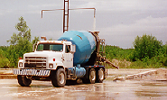
Mixing Water
City Water Supply
Well Water
Reclaimed or Recycled Water
Mixer at Washout Pit

Slide 22
Effects on Concrete due to Chemicals in Mixing Water
Chlorides - High chloride levels promote steel corrosion
Sulfate - High sulfate levels promote expansive reactions due to sulfate attack
Sugars - Small amounts of sugars can retard setting time.
Silt or Suspended Particles - High levels of small particles can increase water demand and bleeding.

Slide 23

Proportioning Considerations
Design Strength
Desired Slump
Entrapped Air
Entrained Air
Coarse Aggregate Factor
Mineral Admixtures
Chemical Admixtures
Water - Cementitious Ratio
Cement Content

Slide 24
Most Important Factor in Concrete Mix Proportioning??

Slide 25
Most Important Factor in Concrete Mix Proportioning??
Water - Cementitious Ratio

Slide 26
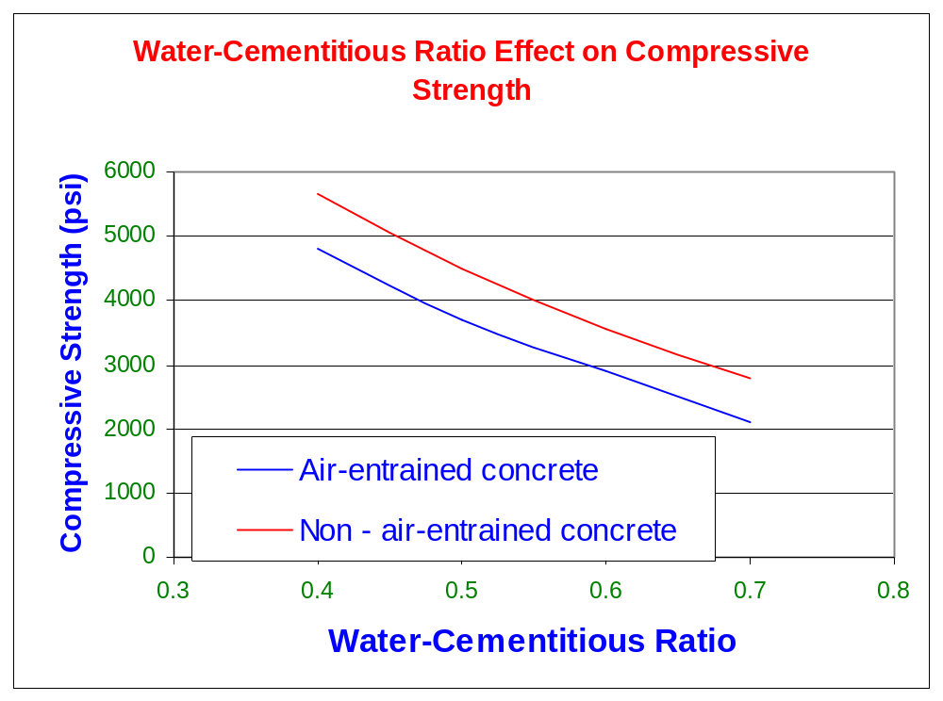
Most Important Factor in Concrete Mix Proportioning??
Water - Cementitious Ratio

Slide 27
Factors That Effect Water Demand
Smaller aggregates increase water demand.
Angular shaped aggregates increase water demand.
Higher slumps require more water.
Higher cementitious contents require more water.
Water reducing admixtures reduce the water required.
Increased entrained air decreases the water demand
Higher ambient temperatures increase required water.

Slide 28
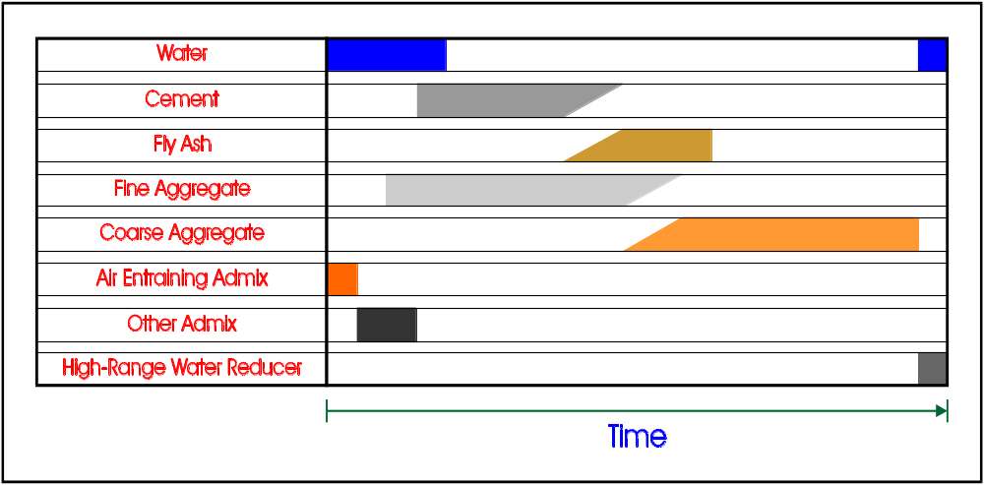
Standard Mixing Procedure

Slide 29
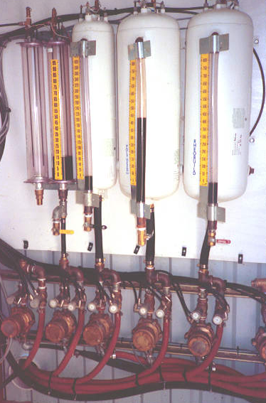
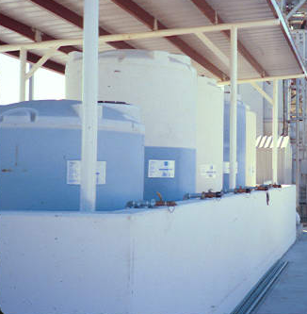
Chemical Admixture
A material other than water, aggregates, hydraulic cement, and fiber reinforcement,used as an ingredient of concrete or mortar
and added to the batch immediately before or during its mixing.
Admix Dispensers
Admix Tanks

Slide 30
Types of Chemical Admixtures
Water-Reducing
Retarding
Accelerating
High-Range Water-Reducing
Air-Entraining Admixture
Other

Slide 31
Why are Chemical Admixtures Used
Reduce Water Demand
Improve Workability
Increase Placeability
Enhance Finishability
Change Mechanical Properties
Increase Durability

Slide 32
ASTM 494 - Type A
Type A - Water Reducing
Minimum 5% water reduction
Initial set not more than 1 hour earlier and not more than 1 ¹/₂ hours later than control.
Low-Range 1st and 2nd Generation Water-Reducers

Slide 33
ASTM 494 - Type B
Type B - Retarding
No water reduction required
Initial set at least 1 hour later but not more than 3 ¹/₂ hours later than control.
Typical Retarder with no water reduction.

Slide 34
ASTM 494 - Type C
Type C - Accelerating
No water reduction required
Initial set at least 1 hour earlier but not more than 3 ¹/₂ hours earlier than control.
Typical Accelerator with no water reduction.

Slide 35
ASTM 494 - Type D
Type D - Water reducing and retarding
Minimum 5% water reduction
Initial set at least 1 hour later but not more than 3 ¹/₂ hours later than control.
1st and 2nd generation water reducing-retarder.

Slide 36
ASTM 494 - Type E
Type E - Water reducing and accelerating
Minimum 5% water reduction
Initial set at least 1 hour earlier but not more than 3 ¹/₂ hours earlier than control.
2nd generation water reducing-accelerators.

Slide 37
ASTM 494 - Type F
Type F - Water reducing, high range
Minimum 12% water reduction
Initial set not more than 1 hour earlier and not more than 1 ¹/₂ hours later than control.
3rd and 4th generation water reducers
(Mid-Range)
High-Range water reducers
(Super Plasticizer)

Slide 38
ASTM 494 - Type G
Type G - Water reducing, high range and retarding
Minimum 12% water reduction
Initial set at least 1 hour later but not more than 3 ¹/₂ hours later than control.
3rd and 4th generation water reducing retarders
(Mid-Range Retarders)

Slide 39
Air-Entraining Admixtures
Added to concrete to generate microscopic bubbles of air during mixing.
Governed by ASTM C 260

Slide 40
Benefits of Air-Entrainment
Plastic Concrete
Hardened Concrete
Improved Workability
Increased Slump
Cohesiveness / Less Segregation
Reduced Bleeding
Increased Yield
Improved Freeze-Thaw and Scaling Resistance
Increased Watertightness

Slide 41
Special Purpose Admixtures
Corrosion Inhibitors
Grout Fluidifiers
Coloring Agents
Pumping Aids
Anti-Washout Admixtures
Admixtures for Cellular or Lightweight fill
Shrinkage Reducing Admixtures
Hydration Control

Slide 42
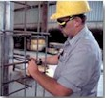
Concrete Placement Preparation
Compacting and Moistening the Subgrade
Erecting Forms
Setting Reinforcing Steel and other Embedded Items Securely in Place

Slide 43

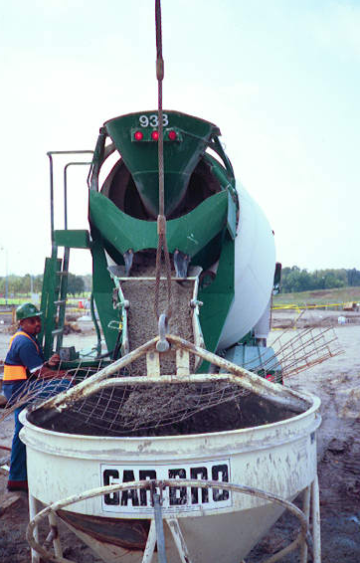
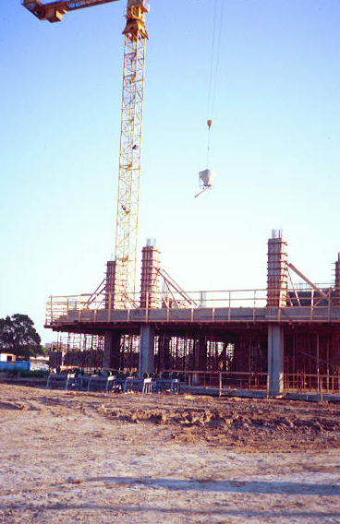
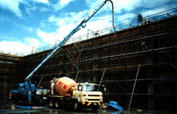
Concrete Placement Methods
Chute Discharge
Concrete Bucket
Pump Truck

Slide 44
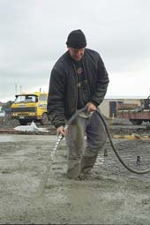
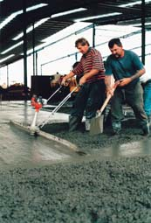
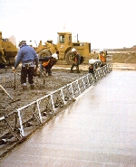
Vibration Methods
Hand
Vibration
Hand Held
Vibratory Screed
Vibratory
Screed

Slide 45
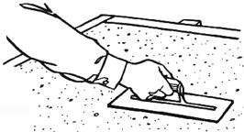
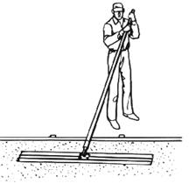
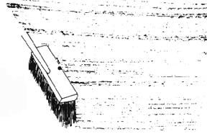
Finishing Methods
Hand Trowel
Bull Float
Broom Finish

Slide 46
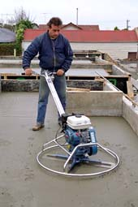
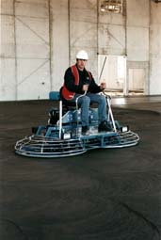
Power Trowels
Hand Operated
Power Trowel
Riding Power
Trowel

Slide 47
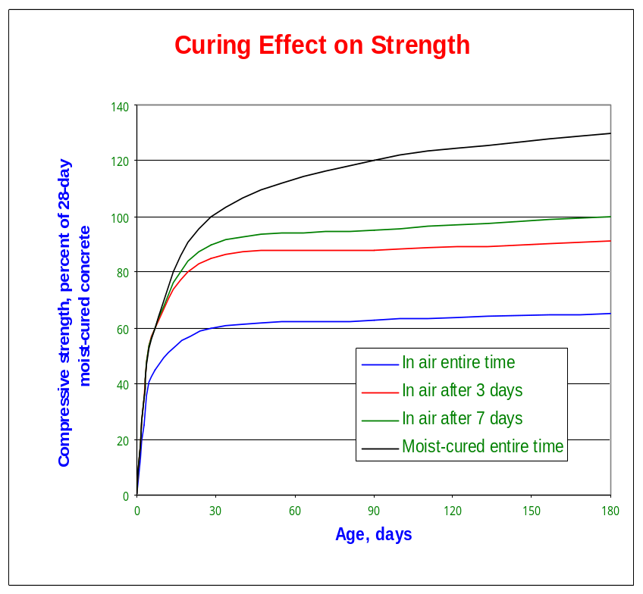
Curing Concrete
Wet Burlap or Cotton
Liquid Membrane Forming Compound
Flooding or Ponding
Sprinklers of Fogging
Plastic Sheets
Insulating Blankets or Covers

Slide 48
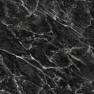
Hot Weather Concreting
Increased Water Demand
Accelerated Slump Loss
Increased Rate of Set
Increasing Plastic Cracking
Reduced Air Entrainment
Critical Need for Early Curing

Slide 49
Using Water to Combat Hot Weather Effects
Increased Water-Cementitious Ratio
Decreased Strength
Decreased Durability
Nonuniform Surface Appearance
Increased Drying Shrinkage

Slide 50
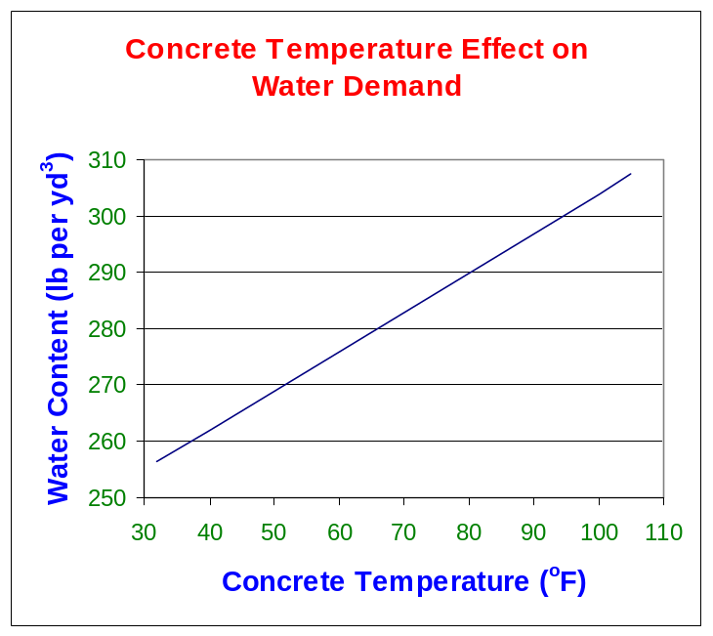
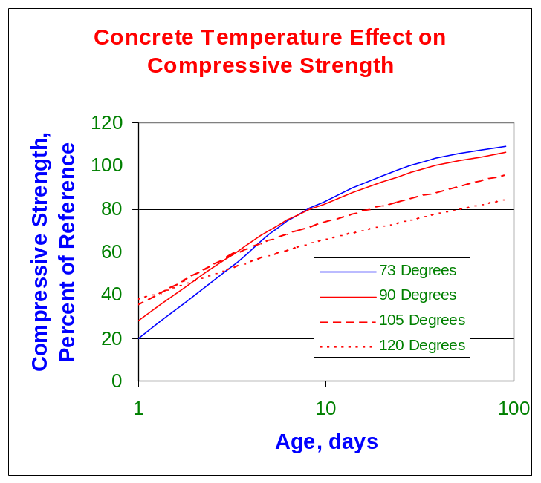
Concrete Temperature Effects
Effect on
Water Demand
Effect on
Compressive Strength
(W/C = 0.45)

Slide 51
Combating Hot Weather
Cooling Concrete Materials
  Wetting Aggregate Stockpiles
  Cooled Water
  Replace Portion of Water with Ice
Wetting Forms, Steel, Subgrade and Equipment
Avoid Long Transportation Times and Prolonged Mixing
Proper Concrete Curing
Use of Retarding Admixtures
Use of Higher Levels of Fly Ash

Slide 52
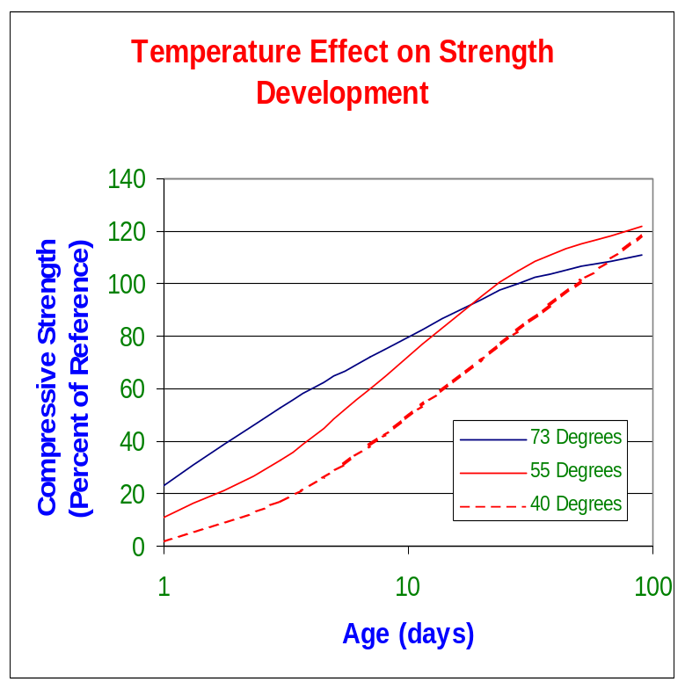
Cold Weather Concreting
Freezing before concrete has achieved 500 psi will result in ultimate strengths 50% lower than reference
Extended set times
Slow strength gain
Increased sensitivity to air entraining admixtures

Slide 53
Combating Cold Temperatures
Portable Heaters
Enclosing Area
Insulating Forms
Using Type III Cement
Adding 100-200 lbs Portland Cement
Chemical Accelerators

Slide 54
Thank You!
Time for Pozz Demonstration

